Slide 1
OVERVIEW OF THE GEC – JM PREFERENCES
Ernesto Cavassa sj
Belén Romá

Slide 2
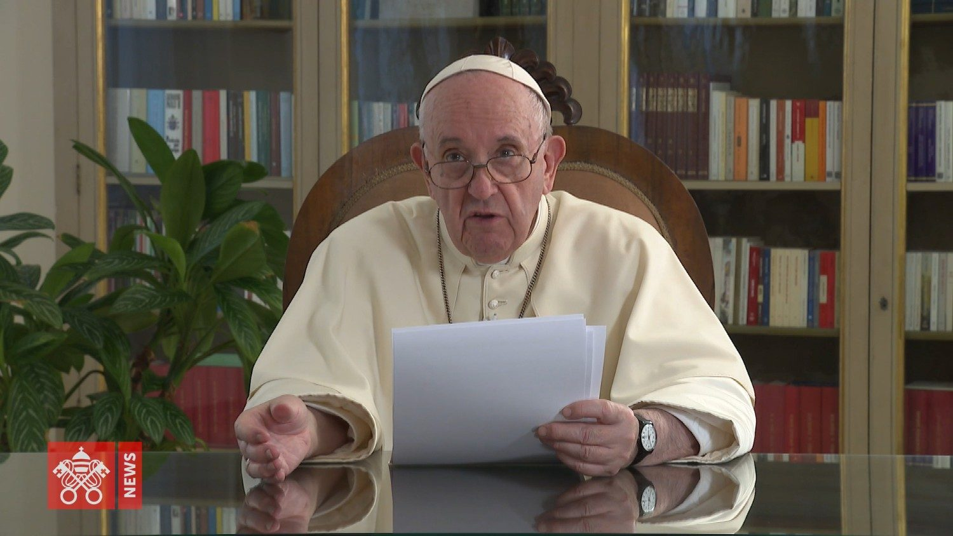
VIDEO TO LAUNCH GEC (12/9/2019)

Slide 3
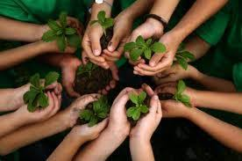
THE PACT: WHAT IT IS AND WHAT IT IS NOT
“For there to be a compact, in fact, there must be two or more people who choose to commit to a common cause. A compact implies choosing to put our strengths at
the service of the same project, albeit maintaining our mutual differences. A compact implies the ability to see others who are different from us as our travelling companions, and not as a threat to our identity”
The Pope does NOT does not suggest educational initiatives, nor does he invite us to develop a new programme. He focuses on a pact or, as he puts it, on an EDUCATIONAL ALLIANCE.
What a pact IS (IL)

Slide 4
IS THIS INITIATIVE NECESSARY?
It is necessary because of the limitations of schools and, in particular, of
Catholic schools.

Slide 5
The Catholic School
IS LOSING… | HAS BECOME… | SHOULD…
LEGITIMACY | Elitist Exclusive Rigid Imposing Closed | Open up Dialogue Welcome all Reach out to the most needy Promote culture of encounter Be more flexible Be more horizontal
AUTONOMY IDENTITY | Dependent Comfortable Following trends Obedient to the Market/the State/Quality | Free itself Reach out Move counter-culturally Generate hope Show humanity
SIGNIFICANCE | Does not have a monopoly on education Losing presence and importance | Innovate Collaborate Transform Grow Bring value
Source: Juan Antonio Ojeda Ortiz, fsc.

Slide 6
Not only is it necessary it is URGENT
URGENT NEED TO CHANGE EDUCATION…
Dehumanised education and society
Outdated education
Reproducing, not transforming
Fragmented and competitive schools
Focus is on the teacher, memorising, imposing
Anchored in the past
Unable to put knowledge into practice
Renew with Passion
Rethink
Reinvent
Reimagine
Catholic Education
Teaching IS NOT EDUCATING
Source: Juan Antonio Ojeda Ortiz, fsc.

Slide 7
ANTECEDENTS The Pope has been saying it (see IL)

Slide 8
ANTECEDENTS EVANGELII GAUDIUM
EG: The Pope invites the entire Church to adopt a constant “going out”, missionary approach in all its activities.

Slide 9
ANTECEDENTS: LAUDATO SI
LS: In the encyclical Laudato sí, Pope Francis reminds us that “Our efforts at education will be inadequate and ineffectual unless we strive to promote a new way of thinking about human beings, life, society and our relationship with nature” (no. 215).

Slide 10
LOGO

Slide 11
The stylized drawing of a world, embraced by a human figure.
COLOURS
GREEN, because it recalls nature, growth, renewal and also hope, the possibility of "sowing" prophetic dreams.
BLUE, to remind us of our spiritual dimension, and also what we would like to contribute to achieving: Peace.
GOLD, to represent the light, the sacred. For every covenant, every covenant for the common good, for the good of humanity, has something sacred in it.
FORMS
At the centre of the world, there is the human person who carries out an action of care and protection of the world, of the Common Home that has been entrusted to them.
The line of the circle symbolizes that macrocosm that is God, and expresses the beginning and the end of everything: being, totality.

Slide 12
WE ARE GOING TO EXAMINE THE INSTRUMENTUM LABORIS DRAWN UP BY THE CONGREGATION FOR CATHOLIC EDUCATION

Slide 13
Global Compact on Education
INSTRUMENTUM LABORIS

Slide 15
Vision: 1. Unity in Difference
1
Value diversity
2
Educational practice: dialogical exercise
3
Role of dialogue for religions and politics

Slide 16
Vision: 2. Relationship at the Centre
1
The importance of the relationship
2
Educational relationship: key. A fruitful education is defined by the quality of the teacher-pupil relationship
3
The person is at the centre
4
Take responsibility for the specific situation of each individual

Slide 17
Vision: 3. The World can Change
1
Central ideal for working with young people
2
Listen to the cry of young people
3
Run the risk of encountering the other

Slide 19
Mission: 1. Education and Society
1
The “village of education”
2
Triple courage
3
Call to create “ecological citizenship”

Slide 20
Mission: 2. Tomorrow Demands the Best we have Today
1
Give our energy to prioritising education; it’s the best investment

Slide 21
Mission: 3. Educating to Serve, Educating is to Serve
1
Education forms people to serve others
2
“The true service of education is education to service”
3
Educational research and service learning
4
Hannah Arendt

Slide 22
Context

Slide 23
1. The Breakdown of Intergenerational Solidarity
1
Anthropological transformation
2
“Egolatry” or “worship of the self”
3
“Together” is the word that saves all and achieves all

Slide 24
2. Educational and Technological Times
1
Contrast between both: technology moves faster (e.g. AI)
2
Altering human relationships
3
Denouncing is not enough, discernment is needed

Slide 25
3. “E-ducating” the Question
1
“Psychological disaggregation”
2
Wealth of stimuli, dearth of interiority
3
“It is necessary to focus today on educating the questions of our youth, which are a priority compared to providing answers.”
4
Revive religious awareness

Slide 26
4. Rebuilding Our Identity
1
Fragmentation of identity
2
"It is therefore necessary to form individuals who can rebuild the broken connection with our memory and our hope in the future: young people who, aware of their roots and open to newness, know how to rebuild a more peaceful con-temporary identity.”

Slide 27
5. The Environmental Crisis as a Relational Crisis
1
Relationship human being - nature
2
“Hence, of course, the need for an integral ecological education”

Slide 28
UNESCO Reimagining our Futures Together A new social contract for education (2021)

Slide 29
“To shape peaceful, just, and sustainable futures, education itself must be transformed.”
Conclusion: “Forging a new social contract for education is a critical step towards reimagining our futures together.”
“Reimagining means working together to create futures that are shared and interdependent.”

Slide 31
1. Fundamental Principles
a.
Guarantee the right to life-long, quality education for all
b.
Highlight education as a public and common good

Slide 32
2. Proposals to renew education:
1
Pedagogy based on collaboration and solidarity
2
Learning that is ecological, intercultural and interdisciplinary
3
Teachers who are producers of knowledge and agents of social transformation
4
Schools that are inclusive, promote fairness and adopt an integral approach
5
Life-long learning and in all cultural contexts

Slide 33
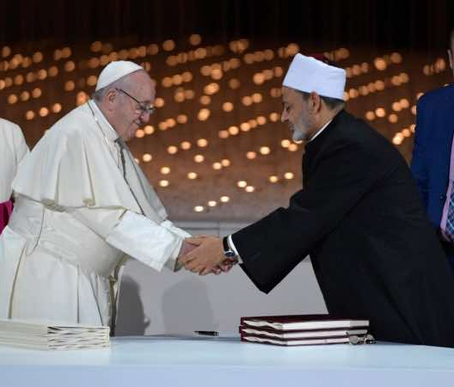
DOCUMENT ON HUMAN FRATERNITY FOR WORLD PEACE AND LIVING TOGETHER (Abu Dhabi, February 2019) Signatories: Francis and Al-Azhar al-Sharif

Slide 34
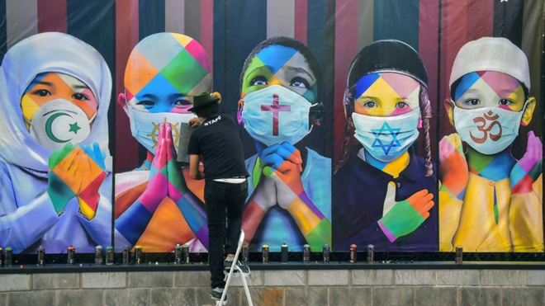
“We affirm also the importance of awakening religious awareness and the need to revive this awareness in the
hearts of new generations through sound education and an adherence to moral values and upright religious
teachings. In this way we can confront tendencies that are individualistic, selfish, conflicting, and also address
radicalism and blind extremism in all its forms and expressions”.
”

Slide 35
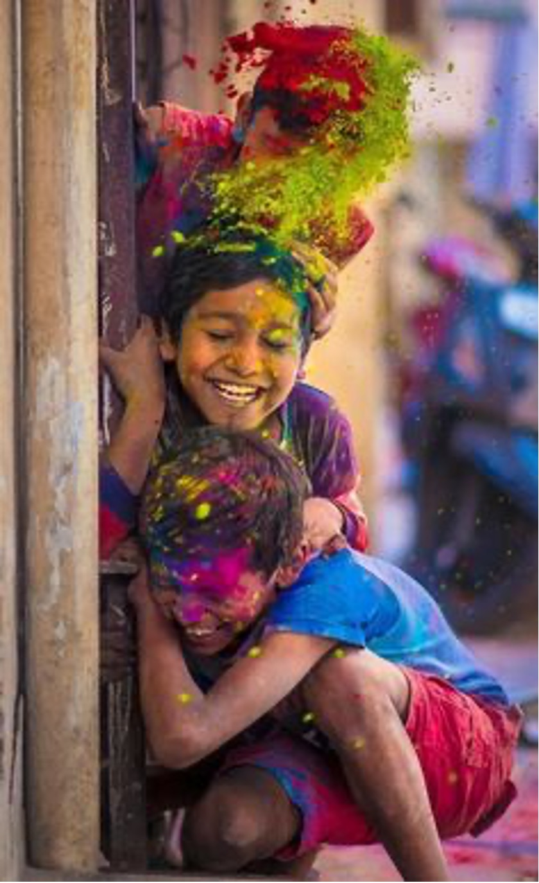
“This Document, in accordance with previous International Documents that have emphasised the importance of the role of religions in the construction of world peace, upholds the following:
The firm conviction that authentic teachings of religions invite us to remain rooted in the values of peace; to
defend the values of mutual understanding, human fraternity and harmonious coexistence; to re-establish
wisdom, justice and love; and to reawaken religious awareness among young people so that future generations may be protected from the realm of materialistic thinking and from dangerous policies of unbridled greed and indifference that are based on the law of force and not on the force of law.”

Slide 36
EDUCATE FOR INTER-RELIGIOUS DIALOGUE IN ITS 4 LEVELS:
Life
Prayer
Action
Theological Reflection

Slide 37
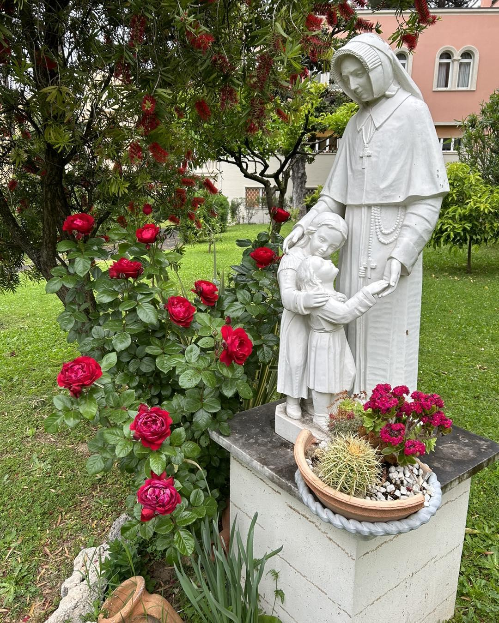
JESUS AND MARY PREFERENCES

Slide 38
We are sent to:
1
Favour spaces to experience an encounter with God
2
Build healthy and just relationships
3
Risk going to the peripheries
4
Go beyond our own boundaries

Slide 39
How?
1
Journeying together, religious and lay, as Companions in Mission
2
Providing formation relevant to our times
3
Living Ignatian Spirituality more deeply
4
Creating flexible structures
5
Initiating projects in response to urgent needs
6
Educating in all social milieux

Slide 40
With preference for:
1
Youth
2
The vulnerable and poor, especially women and children
3
Our Common Home

Slide 41
NECESSARY ATTITUDES

Slide 42
1
Triple courage
2
Openness to newness
3
Passion for education
4
Care

Slide 43
FINAL CALL OF THE INSTRUMENTUN LABORIS

Slide 44
1
Take care of the fragility of people
2
Together promote this education pact and make it real
3
Call to public figures
4
Scientists, artists…

